Slide 1
CIS 454 Project 2
“Sphere Moving Game”
Presented by: Joe Pacitto & Corey Pollock

Slide 2
Phong Model
Sphere materials
Glossy
Diffuse
Wall materials
Mirror / reflective
Diffuse

Slide 3

Camera Tracking
Rotation around xy-axes
Zoom in/out

Slide 4
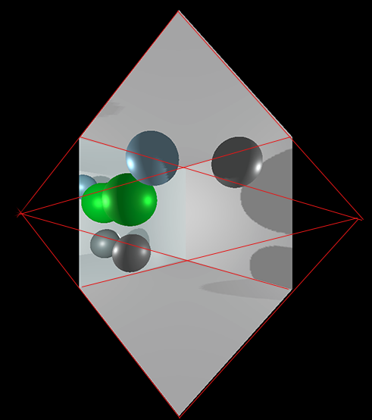
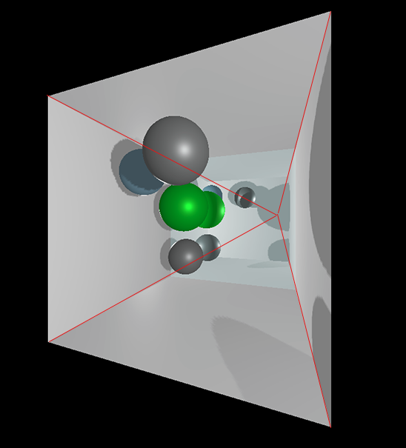
Perspective Projection

Slide 5
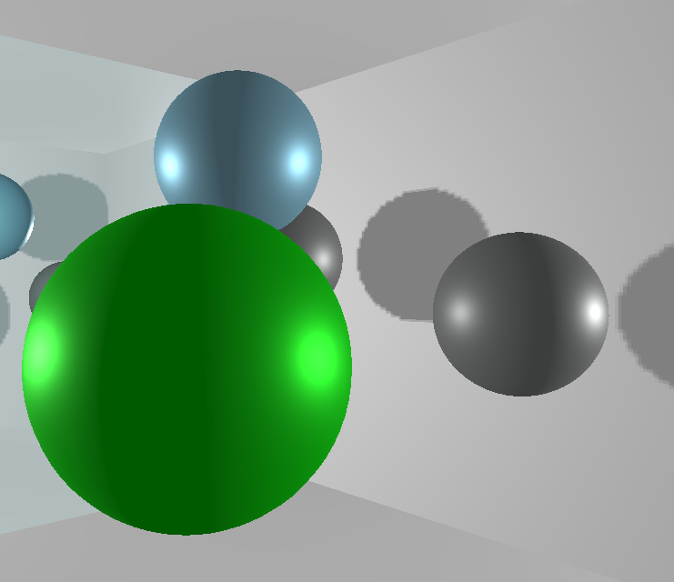
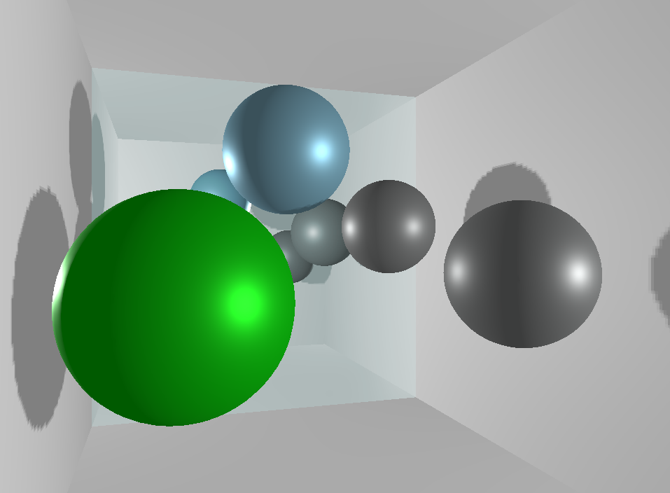
Depth Testing

Slide 6
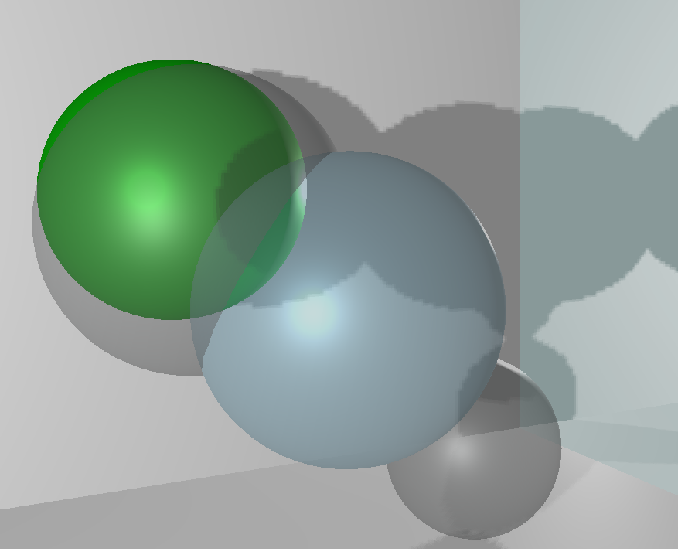
Depth Testing Effects

Slide 7
Xbox controls
Triggers - change wall color
Joystick - orbits camera around scene
DPad & Buttons - move spheres
Left bumper - choose sphere to move
Select - randomly places spheres in the scene

Slide 8
Demo

Slide 9
Questions?

Slide 10
Both team members contributed equally.

